Slide 1
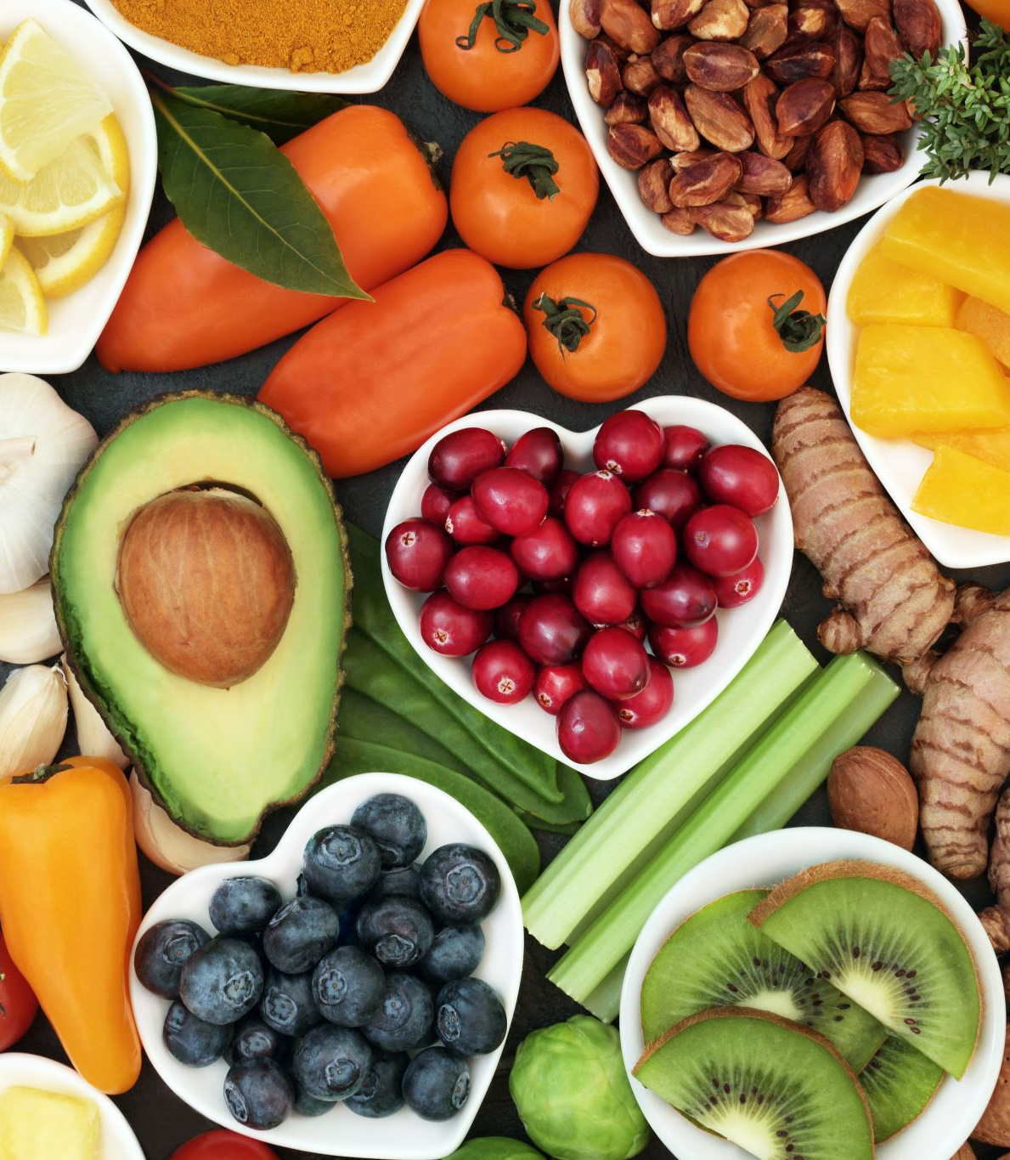
Deep neural network for food image classification and nutrient identification - A systematic review
Presented By
Pasupuleti Rohith Sai Datta

Slide 2
Introduction
This paper looks at how technology affects our health, especially when it comes to using smart computers to understand what we eat through pictures.
It talks about how technology can be good for us by helping us communicate better, but also warns that too much time on social media or using phones can lead to problems like trouble sleeping, feeling sad, or gaining too much weight.
Researchers carefully looked at lots of articles about how technology can help us understand what we eat better.
They found 56 articles out of 771 that were the most helpful. These articles talked about things like how to make computers recognize food in pictures and how to figure out what nutrients are in our food.
The paper talks about why it's important to eat healthy and how different diets can help us stay healthy.

Slide 3
Introduction
It explains that our bodies need different kinds of nutrients like carbohydrates, protein, vitamins, and minerals to stay healthy.
Some diets like the Very-Low-Calorie Ketogenic Diet and the Southern Europe Atlantic Diet can help people lose weight and stay healthy.
The researchers also talk about how we can use phones and other devices to take pictures of our food and use computers to figure out what's in them.
They use fancy computer programs called Deep Learning algorithms to help computers recognize food in pictures.
Overall, the paper tells us that technology can be used to help us eat better and stay healthy by understanding what's in our food.

Slide 4

Background Study
This section discusses the research on different AI-based approaches proposed by researchers for identifying food nutrients using food images.
The review procedure consists of two phases.
The first phase presents the comprehensive review analysis of the papers in which the CNN model is designed from scratch.
The second phase discusses the use of the TL approach in the pre-trained CNN model.

Slide 5
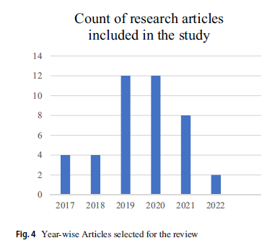
Food Image Analysis with CNN & Object Detection
Researchers have been using new technology called CNNs to understand food pictures better.
They've made tools that can quickly spot food and even guess what's in it, like calories. Other tools can recognize different foods and drinks.
These tools help with things like figuring out what's in your meal or spotting mold on food.
They're getting better all the time and are useful for many things, like helping people eat healthier and understanding different types of food.

Slide 6
Role of TL in the analysis of food images
Transfer Learning (TL) is a smart method for analyzing food images using CNN models.
Instead of starting from scratch, TL uses pre-trained models, saving time and effort.
For example, researchers like Tasci and Hu applied TL with models such as ResNet and DenseNet, achieving high accuracy in recognizing food items.
TL also helped in predicting individuals' food intake sequences, as shown by Qiu et al.
TL has been used in various applications, from estimating calorie intake for the elderly to developing mobile apps for nutritional analysis.
Overall, TL makes food image analysis more efficient and accurate.

Slide 7
Proposed investigations
This study explores food image analysis and other machine learning approaches employed for nutrient identification.
The investigations crucial for assessing the research study are outlined below:
Food Image Datasets for FIC: Examining the variety of datasets available for Food Image Classification (FIC) to understand the diversity and quality of data used in research.
Hyperparameters Optimization: Understanding the different hyperparameters needed to improve the performance of a model, such as learning rate, batch size, and activation functions.
CNN Architecture in FIC: Investigating how Convolutional Neural Network (CNN) architecture provides solutions to the challenges in food image classification, including feature extraction and model training.
Transfer Learning (TL) Strategies: Analyzing the effectiveness of fine-tuning and feature extraction techniques in Transfer Learning (TL) for enhancing FIC performance.
Performance Metrics: Identifying the metrics required to evaluate the effectiveness of FIC models, such as accuracy, precision, recall, and F1-score.
Challenges in Food Image Classification: Exploring the obstacles encountered in classifying food images, such as variations in food appearance, image quality, and dataset size.
These investigations are derived from a comprehensive analysis of previous research in the FIC field and serve as the basis for the proposed research methodology discussed in the subsequent sections.

Slide 8
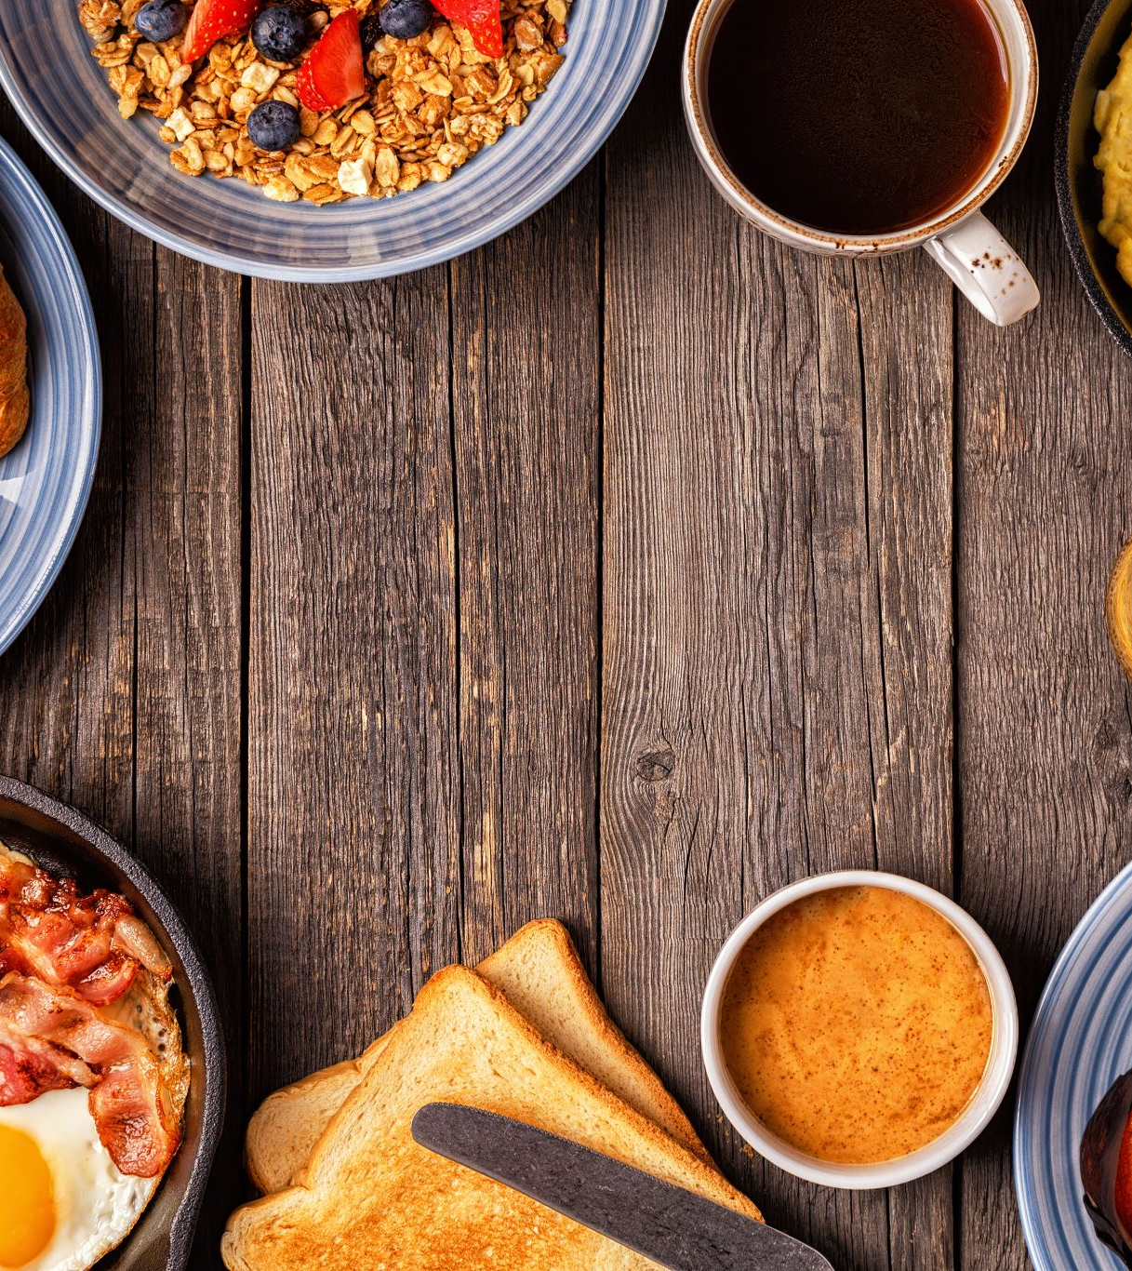
Investigation 1: Understanding Food Image Datasets
We're checking out different sets of food pictures used to teach computers about food. These datasets, like FOOD-101 and UEC-FOOD-256, help researchers compare new methods.
Our summary table and sample images show what's in these datasets and how they're used in food recognition research.

Slide 9
Investigation 2: Understanding Model Hyperparameters
We're looking into the different settings of a CNN, like learning rate and batch size, to make it work better. Each dataset needs its own special settings for accurate predictions, and we experiment to find the best ones.
We can use methods like grid search or random search to fine-tune these settings.

Slide 10
Investigation 3: CNNs for Food Image Recognition
We're exploring how CNNs, like AlexNet and ResNet, help computers recognize food images. These models are fine-tuned to understand the unique features of different foods.
For example, AlexNet was the first to win a major image recognition competition, while ResNet allows for deeper training.
VGGNet uses small filters to classify images, and EfficientNet scales to handle larger images more accurately. These CNN architectures play a big role in improving food image recognition.

Slide 11
Investigation 4: Transfer Learning Strategies
We're checking out how transfer learning helps in food image classification (FIC). With feature extraction, we use existing model features for small datasets and add a new classifier.
For larger datasets, fine-tuning adjusts some layers of the pre-trained model to fit the new data better. However, deciding which layers to adjust can be tricky.

Slide 12
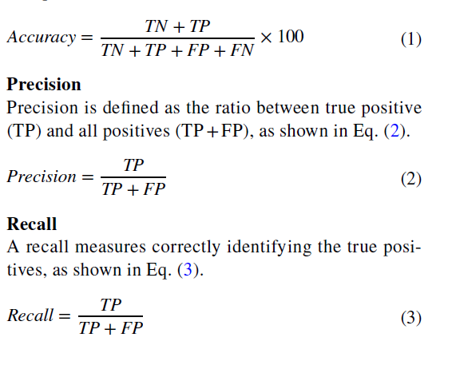
Investigation 5. What metrics are required to measure the performance of a model?
We're studying metrics like accuracy, precision, and recall to measure how well food recognition models perform.
These metrics help assess the model's correctness and effectiveness in identifying different food items.
Notations used in formulas
TN stands for True Negative,
TP for True Positive,
FP for False Positive, and FN for False Negative.

Slide 13
Investigation 6. What are the challenges faced in classifying food images?
We're looking into challenges like overfitting, dataset diversity, and tuning hyperparameters that impact the accuracy of food image classification models.
These hurdles need to be addressed to develop effective models for identifying food items accurately.

Slide 14
Case Study: Food Image Analysis and Detection
Food identification is becoming increasingly important in various fields, such as nutrition management and self-service restaurants.
In this section, we present a case study focused on food image analysis using EfficientNet B0-B6 and food item detection using YOLOv5.

Slide 15
Food image analysis using EfficientNet B0‑B6
We studied models for classifying food images using EfficientNet B0-B6.
Using a dataset with 14 food classes, we trained these models and achieved accuracies ranging from 87.7% to 89.57%.
However, some food classes like apple_pie and bread_pudding were often misclassified due to their similar shapes.

Slide 16
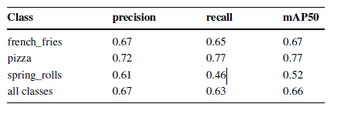
Object detection in food image using YOLOv5
We used YOLOv5 to detect food in images.
After training on a dataset with 3 types of food, we evaluated its performance using metrics like recall, precision, and mAP.
Results are summarized in Table. Sample images with labels are shown, and training and validation curves are depicted in figures.

Slide 17
Conclusion and future aspects
A dietary evaluation and healthcare monitoring system are crucial for tracking nutrient intake and predicting dietary needs.
The systematic review aims to provide insights for building and tuning CNN models for food image processing.
Investigations from previous research are identified to address the Food Image Classification (FIC) problem.
The research methodology proposes solutions for all identified investigations.
Various food image datasets are discussed, including the number of food classes and total images, along with the articles that used them.
A case study demonstrates the application of a food image dataset to train the EfficientNet model, achieving an 86.5% accuracy.
This review will aid in the development of food image-based diet recommendation systems and future advancements in the field.

Slide 18


